Slide 1


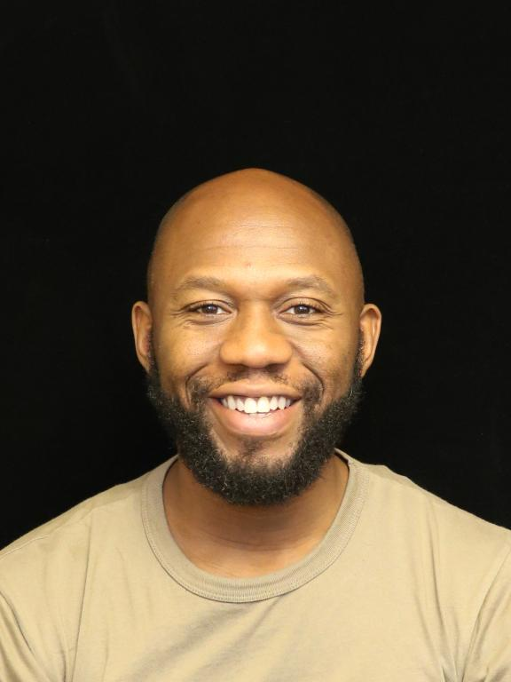
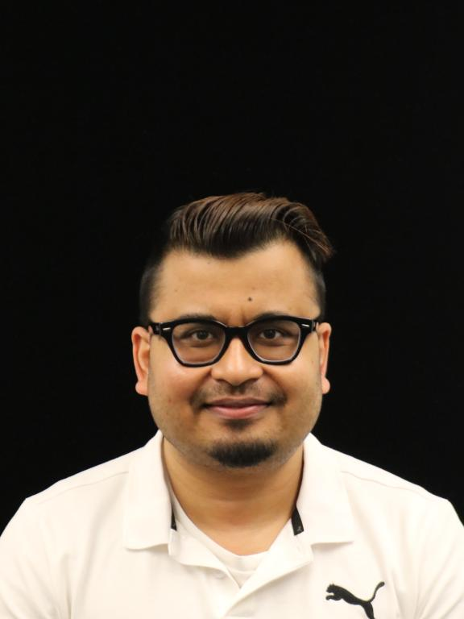
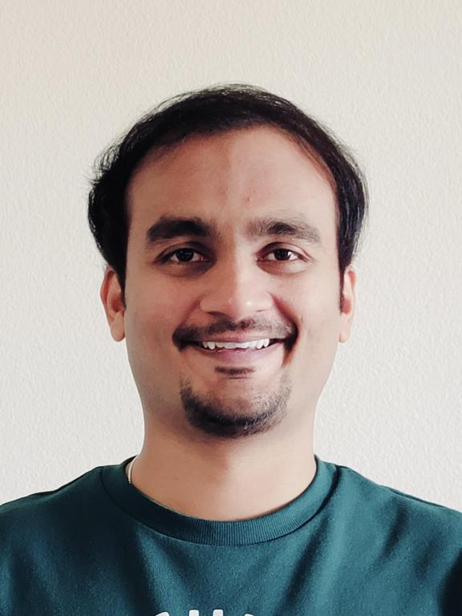

Welcome slide
Generative AI Art Gallery &
VR Experience
Hosted by:
Justin Ossai
GenAI Specialist SA
Gaurav Parekh
Solutions Arch.
Abhishek Srivastav
Snr. Solutions Arch.

Slide 3
Thank you

Slide 4
Multi Agent Collaboration (MAC) with Amazon Bedrock Agents
Jusrtin Ossai
GenAI Labs Specialist SA
Amazon Web Services

